Slide 1


Satellite Internet Communication Using OSI Layers
CSA0711-Computer Networks
Name of the student : Faculty Name:
Dinesh Bharadwaj (192572028) Dr.Shankar.R

Slide 2


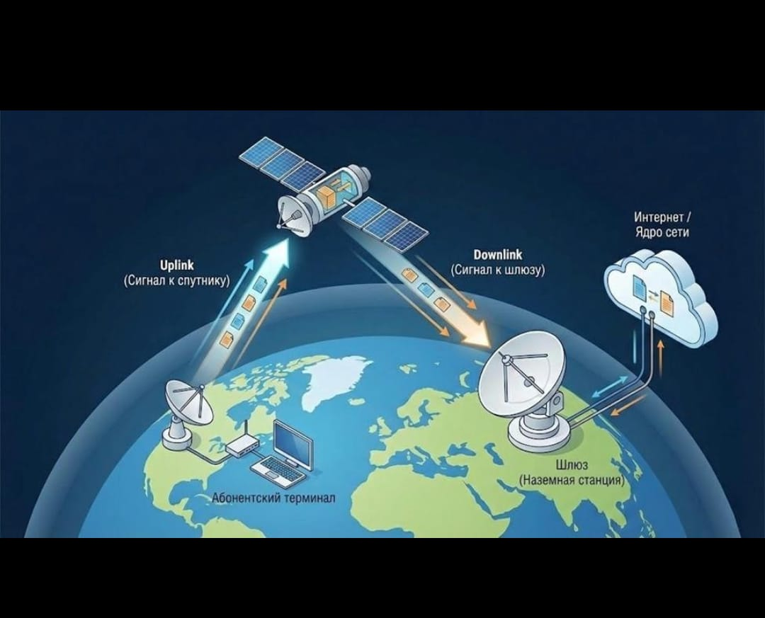
Introduction
Satellite Internet is a wireless communication technology that provides internet access using satellites orbiting the Earth instead of traditional fiber optic cables or mobile towers.
It is especially useful in:
Remote villages
Mountains
Oceans
Aircraft
The Open Systems Interconnection (OSI) model is a seven-layer networking framework that explains how data is transmitted across a network. In satellite communication, each OSI layer performs a specific function

Slide 3
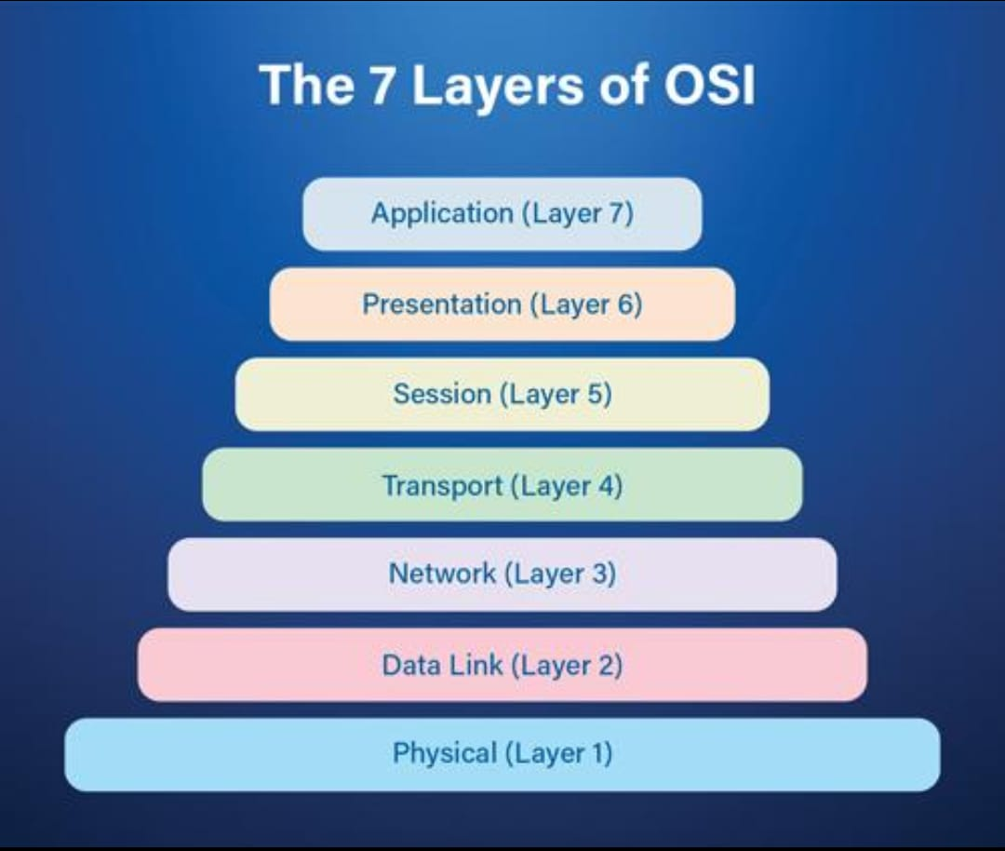
Flow chart
The working of satellite internet communication can be understood by following how data travels through each of the seven OSI layers from the user's device to the satellite and finally to the internet server.
1. Application Layer (Layer 7):
The user opens a web browser or any internet application (e.g., Chrome, YouTube, Email).
The application generates a request, such as opening a website.

Slide 4
2. Presentation Layer (Layer 6):
The data is prepared for transmission.
It performs:
Data formatting
Encryption (for security)
Compression (to reduce data size)
3. Session Layer (Layer 5):
Establishes and manages the communication session between the user's device and the server.
4. Transport Layer (Layer 4):
Divides the data into smaller segments.
Handles:
Error recovery
Flow control

Slide 5
5. Network Layer (Layer 3)
Adds the source and destination IP addresses.
Determines the best path for the data to travel.
6. Data Link Layer (Layer 2)
Converts packets into frames.
Adds MAC addresses.
7. Physical Layer (Layer 1)
Converts digital data into radio frequency (RF) signals.
The satellite receives, amplifies, and retransmits the signals to the ground station.
The ground station forwards the data to the internet.

Slide 6
Advantages
Provides Internet access in remote and rural areas.
Covers large geographical regions.
Useful during disasters when terrestrial networks fail.
Supports communication for ships, aircraft, and military operations.

Slide 7
Applications
Rural broadband Internet
Television broadcasting
Weather monitoring
GPS and navigation
Maritime and aviation Internet

Slide 8


